Slide 1
Select Your Generative AI Vendor
Choose the right tool and vendor by preparing the right selection criteria.

Slide 2
Table of Contents
3 Analyst Perspective
4 Executive Summary
6 Executive Brief
13 Step 1.1: Set the Context
20 Step 1.2: Build Your Selection Criteria
33 Next Steps
35 Bibliography

Slide 3


Analyst Perspective
Andrew Kum-Seun Research Director,
Application Delivery & Management Info-Tech Research Group
Look past the Gen AI hype
AI continues to be an important focus area for organizations looking to optimize, modernize, and innovate. The industry is seeing an increasing number of AI capabilities embedded in organizations over the past five years (McKinsey, 2022). During this time, generative AI (Gen AI) has matured to the point that it is being successfully embedded in key business and IT capabilities. Many vendors acknowledge these opportunities and are building Gen AI into their products. However, organizations are having trouble selecting what is right for them.
The rapid evolution of Gen AI technologies and constantly changing vendor and open-source landscape often impede the learning, understanding, and implementation of Gen AI. Stick with brands you know and trust to ensure you are getting the support you need. Focus on the use cases that matter to your end users and instill confidence for further adoption while minimizing complexity, cost, and risk as much as possible.
Bhavya Vora Research Analyst,
Special Projects Info-Tech Research Group

Slide 4



Executive Summary
Your Challenge
Common Obstacles
Info-Tech’s Approach
Competitive differentiation, cost optimization, digital transformation, and operational efficiency are just some of your strategic priorities that generative AI (Gen AI) promises to support.
Your stakeholders are ready to invest in Gen AI vendors and to investigate and demonstrate opportunities in your teams, products, and services with Gen AI embedded.
Gen AI is new to your organization. The lack of internal capabilities to assess, select, and procure Gen AI tools creates confusion on navigating the vast Gen AI marketplace and developing the right criteria to select the appropriate solutions.
The Gen AI marketplace is very broad and diverse and is constantly changing. Finding the right tools is confusing and overwhelming.
Gen AI can generate significant organizational changes, and current systems, processes, and roles may not be ready or able to adopt them. Vendors may not be able to accommodate your way of working in the configuration, implementation, and operational support of their tools.
Many Gen AI solutions are currently open-source, but teams and stakeholders can be hesitant about its adoption, its long-term viability, the risks, and the costs of ongoing support. Open-source needs skills beyond what commercial software typically requires.
Outline the value you expect to gain. Discuss current business and IT priorities, use cases, and value opportunities to determine what to expect from Gen AI tools.
Define your vendor and tooling selection criteria. Clarify the driving factors in your evaluation of Gen AI solution using your existing vendor evaluation practices as a starting point.
Use Info-Tech’s Generative AI Vendor Selection Criteria Workbook to define and prioritize the selection criteria that will influence vendor selection.

Slide 5
Insight summary
Overarching insight: Invest in the Gen AI tools that strike an acceptable balance between your use cases and the risks and costs of implementing and operating them.
Vendors with ready-to-use solutions, a proven track record, and canned templates of demonstratable use cases are good starting points. Position your Gen AI tool pilots to assess the organizational fit of Gen AI and build the foundational competencies to support it.
Don’t get caught in the hype; focus on the problem.
Gen AI marketing can take your focus away from what is important. Put the human front and center to understand how Gen AI tools can be integrated and embedded into a worker’s activities and workflows and how it drives organizational, department, and individual value.
Treat Gen AI as any other technology in IT procurement.
Much of the selection criteria (e.g. features and functionalities, security, vendor viability) in traditional vendor selection still apply for Gen AI. Adjust your current vendor selection practice to accommodate the context, intricacies and nuances of Gen AI using your existing selection framework and methodologies as a starting point.
Innovate with a purpose.
Do not reinvent the wheel and lower your risk of success. Stick to the use cases proven successful in your prospective Gen AI vendor to understand their value and fit in your organization and how your teams can transform the way they work. Use your lessons learned to discover scaling opportunities.
Position your prospective vendor as a partner and not just a trainer.
Success goes beyond the pilot. It involves the development of a practice that is often supported and supplied with tailored tactics and on-hand advice from the vendor.

Slide 6




What is Gen AI?
Generative AI (Gen AI)
Gen AI
A form of ML whereby, in response to prompts, a Gen AI platform can generate new output based on the data it has been trained on. Depending on its foundational model, a Gen AI platform will provide different modalities and use case applications.
Artificial Intelligence
Machine Learning (ML)
The AI system is instructed to search for patterns in a dataset and then make predictions based on that set. In this way, the system learns to provide accurate content over time. This requires a supervised intervention if the data is inaccurate. Deep learning is self-supervised and does not require intervention.
Machine
Learning
Artificial Intelligence (AI)
Deep
Learning
A field of computer science that focuses on building systems to imitate human behavior. Not all AI systems have learning behavior; many systems (such as customer service chatbots) operate on preset rules.
See Info-Tech’s Generative AI: Market Primer for more information.
Info-Tech Insight
Many vendors have jumped on Gen AI as the latest marketing buzzword. When vendors claim to offer Gen AI functionality, pin down what exactly is generative about it. The solution must be able to induce new outputs from inputted data via self-supervision – not trained to produce certain outputs based on certain inputs.

Slide 7
Organizations are eager to adopt Gen AI, yet success remains elusive
Scalability presents a significant challenge
About three-quarters (76%) of C-suite executives that leverage AI to achieve their growth objectives report they struggle with how to scale (Accenture, 2019; N=1,500).
76%
Inevitable leap from experimentation to implementation
75%
Three-quarters (75%) of C-level executives believe if they don’t move beyond experimentation to aggressively deploy AI across their organizations they risk going out of business by 2025 (Accenture, 2019; N=1,500).

Slide 8



The Gen AI marketplace is large and fragmented
Lack of transparency
76% of CEOs are most concerned with the potential for bias and lack of transparency when it comes to AI adoption (PwC, 2018).
Unstable marketplace, poised for growth
Unconventional pricing standards
Up to the year of 2030, the AI marketplace is expected to grow at a CAGR of 38.1% (Bloomberg, 2023).
Many organizations still find the technology to be prohibitively expensive. Only the top 1% of companies can comfortably afford the latest tools (CPA Practice Advisor, 2022).
Diverse vendor landscape
Lack of adequate regulation
There are over 58,000 vendors in the AI marketplace (Traxcn, 2023).
64% of CEOs are concerned with compliance and regulation challenges within their industry (PwC, 2018).
See Info-Tech’s Generative AI: Market Primer for more information.

Slide 9



Selecting the right Gen AI vendor is crucial
Organizations often get caught in the marketing hype and overpromises of vendors. This motivation leads some organizations to implement a solution only to find out that it does not fit their needs.
A common reason this situation happens is failing to ask the right questions up-front to realize the true capacity and fit of a solution versus its marketing gimmick.
Implementing Gen AI is an organization-wide effort
Building Gen AI responsibly mitigates the risk
Your vendor is your implementation partner
Seventy percent of a company’s AI scaling efforts mount to business and people transformation (Boston Consulting Group, 2023). Since a company is significantly leveraged during AI transitioning, it’s important to make efficient use of resources.
At this stage, the barrier to widespread AI deployment is no longer the technology itself; rather, it’s a set of challenges that ironically are far more human: ethics, governance, and human values (MIT Technology Review, 2020). Access to sensitive data makes it crucial to partner with the right vendor.
Due to the complexity and nascency of this space, the ecosystem of AI implementation partners is not as mature as in other technology domains. In the case of AI, selecting the vendor is equivalent to selecting your implementation partner.

Slide 10
Understand the challenges of selecting Gen AI vendor
Lack of internal resources to support Gen AI
Lack of success stories
Organizational resistance
Lack of technical Gen AI expertise
Vendors lack experience and proven track record
Significant retraining potentially required
Unsuitable technology infrastructure and poor data quality
Nascent development; difficult to define successful adoption
Fear of being replaced
Lack of clarity with respect to Gen AI scope
Doubts over accuracy and claims of functionality
Business leaders still exploring possibilities of how Gen AI fits in
Vendors offering siloed tools, that don’t integrate well with others
Uncertainty in a rapidly evolving space
Fragmented market with asymmetric information
See our Rapid Application Selection Framework research for more information on selecting applications.
See our Drive Successful Sourcing Outcomes With a Robust RFP Process research for more information.

Slide 11
Selecting a Gen AI vendor does not have to be complicated
Key considerations while navigating the Gen AI marketplace
Recommended criteria to evaluate prospective Gen AI vendors
3
4
Features & Functionalities
Open-source vs. commercial solutions
Established organization vs. new entrant
Customization & Flexibility
2
5
Support & Maintenance
Third-party assessments and references
Refer to successful industry use cases
Security
Vendor Viability & Vision
1
6
Affordability
Maintain human-in-the-loop
Set vendor performance metrics
Ease of Integration & Deployment
Scalability

Slide 12

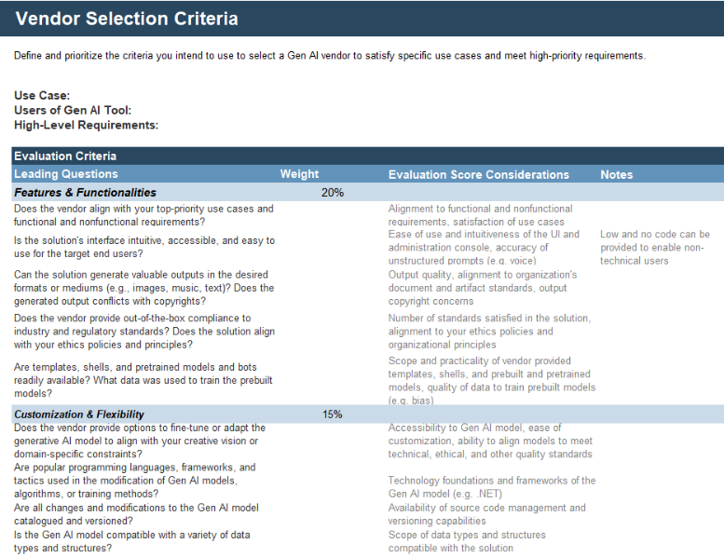
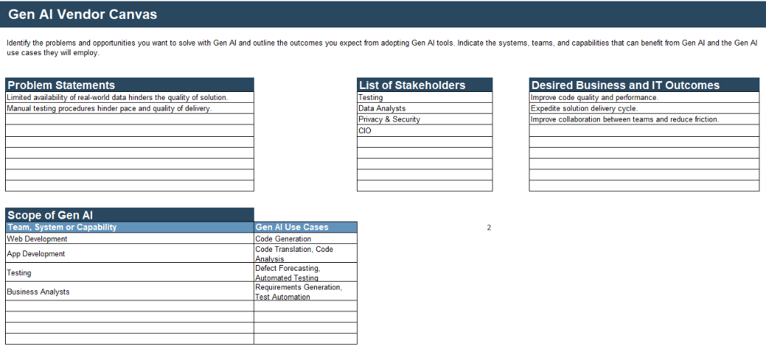
Research deliverable
This research is accompanied by a supporting deliverable to help you accomplish your goals.
Generative AI Vendor Selection Criteria Workbook
Use this tool to document the key factors to consider in the scoring and comparison of prospective vendors and tools. It also contains a canvas to identify the problems, objectives and scope of your Gen AI initiative.

Slide 13
Step 1.1
This step involves the following participants:
IT Procurement
IT Directors and VPs
Enterprise Architects
Business Department Lead
IT Delivery and Support Team
Set the Context
Activities
1.1.1 Build your Gen AI canvas
Select Your Generative AI Vendor
Outcomes of this step
A Gen AI Use Case Canvas that will articulate the application for implementing Gen AI
Step 1.1
Step 1.2

Slide 14




Understand the problems Gen AI is intended to solve
What problems can Gen AI help alleviate?
Inconsistent data quality
Repetitive, error-prone, and manual tasks leading to high operational costs and slow throughput
Outputs are not tailored to the specific demands of the requestor
Lower the barrier to entry for activities traditionally performed by specialists
Quickly reacting to changing business and technology conditions and scenarios (e.g. system instability, security incident)
Make data-driven decisions with trustworthy forecast insights
Gen AI is transforming all industries in how they work, generate value, and innovate.
Healthcare
Utilities
Education
Insurance
Chatbots can be used as conversational patient assistants for personalized interactions based on the patient’s questions.
Analyze customer data to identify usage patterns and generate targeted offerings leveraging energy efficiency programs.
Generate personalized lesson plans for students based on their past performance, learning styles, and current skill level.
Improve underwriting by inputting claims data from previous years to generate optimally priced policies and uncover reasons for losses.
Source: McKinsey, 2023
See Info-Tech’s Build Your Generative AI Roadmap for more information.

Slide 15





Set reasonable Gen AI outcomes
VALUE
COST SAVINGS
PRODUCTIVITY
QUALITY
Gen AI increases the reach of organizations into existing and new markets, generates new value generation opportunities, and improves reception of current products.
“The biggest reported revenue effects [with AI] are found in marketing and sales, product and service development, and strategy and corporate finance.”
Source: McKinsey, 2022
Gen AI can lead to cost savings by automating repetitive and standard tasks and reducing the need for extensive iterations.
Gen AI platforms could reduce design timelines by up to 90% for infrastructure projects, cutting raw material use by up to 95%.
Source: CB Insights, March 2023
Gen AI can improve a worker’s effectiveness by automating manual, error-prone tasks and creating new ways to innovate.
Developers using Microsoft’s Copilot say they were more productive (88%); they can focus on higher-value, more satisfying work (74%); and they spend less time looking for information (77%).
Source: Microsoft Blog, 2023
These projects will improve future innovation capabilities and decrease risk by improving technology maturity.
Capital One used Gen AI functionality to reduce false positives by 75% and improve fraud detection rates by 8%.
Source: Finextra, 2023

Slide 16
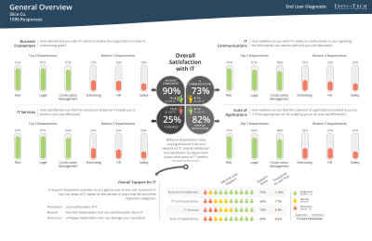
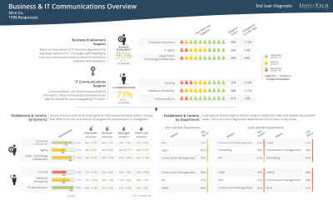
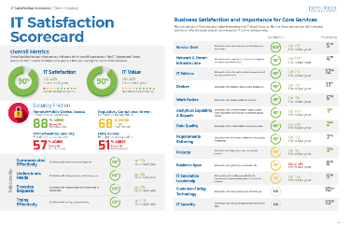
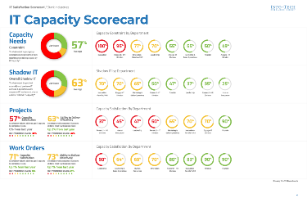
Measure your Gen AI success
Your metrics and KPIs depend on your Gen AI business and technical goals and objectives.
Leverage Info-Tech’s Diagnostics
Improvement in user satisfaction The satisfaction of user requirements, resolves a user’s queries effectively, and provides a positive user experience. Examples: End user satisfaction, application traffic and functional use, net promoter score
Increased worker productivity and performance Demonstratable and measurable quality and throughput enhancements due to the use of Gen AI in the completion of business processes. Examples: time spent completing a process, number of defects and errors, scope of output
Increased return on investment (ROI) The monetary value received compared to its implementation and operational costs. Examples: average revenue per user, profit margins, market reach, scope of Gen AI adoption, customer acquisition costs, product and service utilization, licensing costs, vendor and operational costs
Improved IT effectiveness The ability for IT to effectively support the Gen AI solution, manage and operate its infrastructure, and facilitate the onboarding and training of Gen AI users and stakeholders. Examples: IT satisfaction, turnaround of help desk tickets, system performance, service disruptions, system recovery time
End User Feedback
Value of Gen AI platform and the satisfaction of the users creating and managing Gen AI bots
Scope of Gen AI adoption
Value of the apps enabled or modernized with Gen AI
Improvements in end user support
CIO Business Vision
Improvements to IT satisfaction and value due to the use of Gen AI
Changes to the value and importance of IT core services to support Gen AI
The state of business and IT relationships
Capability to deliver and support Gen AI effectively

Slide 17
Overcome your challenges and satisfy your objectives with the right use case
Examples of Gen AI use cases

Interview Scribe
Domain Research
Translation
Record all stakeholder interviews, provide a transcript of the discussion, and assess and prepare the content for future use.

Generate foundational and introductory content at the start of a project to jump start research and analysis.

Translate content into the preferred language of stakeholders and teams.
Requirements Creation
Code Generation
Data Generation


Learn patterns and automatically generate code.

Create artificial data that mimics the structure of real-life data.
Generate a preliminary list of requirements for validation, reducing elicitation time and effort.
Defect Forecasting
Test Automation
Design & Prototyping

Predict and proactively address defects before they occur.

Create test cases, suites and scripts for a broad range of scenarios using prompts and functional and non-functional requirements.

Analyze existing patterns and principles to generate design, layouts, and working solutions.
See our Identify and Select Pilot AI Use Cases for more information on pilot use case selection.
See our Build Your Generative AI Roadmap for more information on Gen AI use cases.

Slide 18
1.1.1 Build your Gen AI canvas
Output
Gen AI Use Case Canvas
Participants
IT Procurement IT Directors and VPs Enterprise Architects Business Department Lead IT Delivery and Support Team
1-3 hours
Complete the following fields to build your Gen AI canvas in the Generative AI Vendor Selection Criteria Workbook:
Problem Statements – The business and IT challenges and opportunities Gen AI is expected to address
List of Stakeholders – The roles who are impacted by Gen AI
Desired Business and IT Outcomes – Measurable results your stakeholders are looking to achieve with Gen AI
Scope of Gen AI
Team, System, or Capability – Proposed areas that will leverage or be changed with Gen AI
Use Cases – Description on how Gen AI will be used by the team, system, or capability.
Record the results in the Generative AI Vendor Selection Criteria Workbook
Info-Tech Research Group | 18

Slide 19

1.1.1 Example
Problem Statements
Limited availability of real-world data hinders the quality of solution.
Manual testing procedures hinder pace and quality of delivery.
List of Stakeholders
Testing team
Data Analysts
Privacy and Security Team
Application director
CIO
Desired Business and IT Outcomes
Improve code quality and performance.
Expedite solution delivery cycle.
Improve collaboration between teams and reduce friction.
In-Scope Teams, Systems, or Capabilities
Web Development
App Development
Testing
Quality Assurance
Business Analysts
UI/UX design
Use Cases
Code Generation
Code Translation, Code Analysis
Defect Forecasting, Automated Testing
Requirements Gathering, Test Automation

Slide 20
Step 1.2
This step involves the following participants:
IT Procurement
IT Directors and VPs
Enterprise Architects
Business Department Lead
IT Delivery and Support Team
Build Your Selection Criteria
Activities
1.2.1 Build your selection criteria
Select Your Generative AI Vendor
Outcomes of this step
Proposed Gen AI vendor selection scoring criteria
Step 1.1
Step 1.2

Slide 21
Build your Gen AI vendor selection against eight key criteria
»
Features & Functionalities
»
Customization & Flexibility
The capabilities and services the Gen AI solution provides and enables.
The ease to configure, modify, and alter the solution to meet unique needs of the user.
»
Support & Maintenance
»
Security
The guidance and assistance in the use of the solution and ensure the solution’s operations.
The security protocols, controls, and mechanisms in place to protect the solution, bots, data and integrated systems.
»
Vendor Viability & Vision
»
Affordability
The alignment of a vendor’s experience, approach, direction, and outlook of the solution to your organizational strategy.
Implementation and operational costs of the solution and dependent resources are reasonable.
»
Ease of Integration & Deployment
»
Scalability
Ability to connect the solution to your systems and tools and flexible deployment to the environment of your choice.
The capability to add resources to support high demand and extend the solution’s use cases.
See Info-Tech’s Generative AI: Market Primer for more information.

Slide 22
Leading Questions to Define Your Scoring Factors
Criteria:
Features & Functionalities
1
Use Cases & Requirements
Discussion: Does the vendor align with your top-priority use cases and functional and non-functional requirements?
Examples of Scoring Factors: Alignment to functional and non-functional requirements, satisfaction of use cases.
2
Intuitiveness & Ease of Use
The capabilities and services the Gen AI solution provides and enables.
Discussion: Is the solution's interface intuitive, accessible, and easy to use for the target end users?
Examples of Scoring Factors: Ease of use and intuitiveness of the UI and administration console, accuracy of unstructured prompts (e.g. voice).
3
Output Quality & Variety
Discussion: Can the solution generate valuable outputs in the desired formats or mediums (e.g. images, music, text)?
Examples of Scoring Factors: Output quality, alignment to organization's document and artifact standards, output copyright concerns.
4
Industry Standards, Regulations & Responsible AI
Discussion: Does the vendor provide out-of-the-box compliance to industry and regulatory standards? Does the solution align with your ethics policies and principles? Does the generated output conflicts with copyrights?
Examples of Scoring Factors: Number of standards that is satisfied in the solution, alignment to your ethics policies and organizational principles.
5
Templates & Pretrained Models
Discussion: Are templates, shells and pretrained models and bots readily available? Are templates, shells and pretrained models and bots readily available? What data was used to train the prebuilt models?
Examples of Scoring Factors: Scope and practicality of vendor provided templates, shells and prebuilt and pretrained models, quality of data to train prebuilt models (e.g. bias).

Slide 23
Leading Questions to Define Your Scoring Factors
Criteria:
1
Gen AI Model Adaption
Customization & Flexibility
Discussion: Does the vendor provide options to fine-tune or adapt the generative AI model to align with your creative vision or domain-specific constraints?
Examples of Scoring Factors: Accessibility to Gen AI model, ease of customization, ability to align models to meet technical, ethical, and other quality standards.
2
Programming Languages & Frameworks
The ease to configure, modify and alter the solution to meet unique needs of the user.
Discussion: Are popular programming languages, frameworks and tactics used in the modification of Gen AI models, algorithms, or training methods?
Examples of Scoring Factors: Technology foundations and frameworks of the Gen AI model (e.g. .NET).
3
Source Code Management
Discussion: Are all changes and modifications to the Gen AI model catalogued and versioned?
Examples of Scoring Factors: Availability of source code management and versioning capabilities.
4
Data Compatibility
Discussion: Is the Gen AI model compatible with a variety of data types and structures?
Examples of Scoring Factors: Scope of data types and structures compatible with the solution.
5
Model Retraining
Discussion: Is the Gen AI model continuously retrained with fresh data?
Examples of Scoring Factors: Frequency of retraining of the Gen AI model using the past solution outcomes, ease to prepare training data for retraining.

Slide 24
Leading Questions to Define Your Scoring Factors
Criteria:
Support & Maintenance
1
Service Level Agreement (SLA)
Discussion: Is there an SLA that outlines the vendor's commitments regarding response times and issue resolution?
Examples of Scoring Factors: Alignment of SLAs to the team's support needs.
2
Support Channels
The guidance and assistance in the use of the solution and ensure the solution’s operations.
Discussion: Are there designated support channels, such as email, phone, or a dedicated support portal?
Examples of Scoring Factors: Availability of various support channels.
3
Training & Onboarding
Discussion: Does the vendor provide training and onboarding?
Examples of Scoring Factors: Quality of training and onboarding resources, including videos, tutorials, and personal support.
4
Team & Peer Collaboration
Discussion: Can multiple users or teams collaborate within the solution? Does the vendor provide forums to enable discussion and sharing among peers?
Examples of Scoring Factors: Health of the community, number of members, degree of involvement of members, availability of collaboration features in the solution.
5
Bot Portfolio Management & Monitoring
Discussion: Does the solution provide a dashboard to monitor the modifications, uses, value and performances of the Gen AI bots?
Examples of Scoring Factors: Scope of the solution's administration console, alignment of administration capabilities to your IT policies, ability to track the inventory of deployed Gen AI bots.

Slide 25
Leading Questions to Define Your Scoring Factors
Criteria:
Security
1
Alignment with Security Policies
Discussion: Does this vendor comply with your organization’s security policies?
Examples of Scoring Factors: Satisfaction of security, privacy, and confidentiality policies.
2
Secured Data Management
The security protocols, controls and mechanisms in place to protect the solution, bots, data, and integrated systems.
Discussion: Are training and operational data managed and governed separately to abide privacy and confidentiality requirements?
Examples of Scoring Factors: Data management and governance practices for training and operational data.
3
Access Management
Discussion: Does the solution provides role-based access and monitors user activities?
Examples of Scoring Factors: Availability of access management and user monitoring.
4
Gen AI Bot Security
Discussion: Does the vendor provide sufficient protection of their Gen AI bots to prevent IP and data leakage?
Examples of Scoring Factors: IP and data leakage protection protocols.

Slide 26
Leading Questions to Define Your Scoring Factors
Criteria:
Vendor Viability & Vision
1
Market Experience & History
Discussion: Are they an established player with a proven track record or a new and untested entrant to the market? What is the financial health of the vendor?
Examples of Scoring Factors: Age and version history of the solution, scope of deployed releases and fixes, history in the marketplace and industry.
The alignment of a vendor’s experience, approach, direction and outlook of the solution to your organizational strategy.
2
Product Roadmap
Discussion: Does the vendor have a cogent and realistic product roadmap? Are they making sensible investments that align with your organization’s internal direction?
Examples of Scoring Factors: Alignment of the solution's vision and roadmap with your broader organization's strategy and roadmap.
3
Market Prescence & Engagement
Discussion: Does the vendor engage and collaborate with peers in the industry and marketplace?
Examples of Scoring Factors: Participation in open-source communities, involvement in conferences.
4
Vendor Portfolio & Commitment
Discussion: What is the scope of Gen AI solutions in the vendor's portfolio? How committed are they to the particular solution category?
Examples of Scoring Factors: Size and diversity of the vendor's portfolio, investments in the innovation and modernization of their Gen AI solutions.

Slide 27
Leading Questions to Define Your Scoring Factors
Criteria:
Affordability
1
Pricing Transparency
Discussion: Does the vendor provide transparent pricing information and options for different budget requirements?
Examples of Scoring Factors: Licensing costs, clarity of pricing structure, confidence in long-term cost estimates.
2
Skills & Resources
Implementation and operational costs of the solution and dependent resources are reasonable.
Discussion: Do you need to bring in or train specialized labor to implement and maintain the solution (e.g. FTE developers or BI analysts)?
Examples of Scoring Factors: Labor costs, training, and onboarding costs
3
Free & Demo Versions
Discussion: Are free or demo versions available for teams to test and experiment with the solution's features and capabilities?
Examples of Scoring Factors: Availability of fully-featured free or demo versions of the solution.
4
Operational Costs
Discussion: What is the cost to leverage vendor infrastructure to operate and support the solution?
Examples of Scoring Factors: Operational costs.

Slide 28
Leading Questions to Define Your Scoring Factors
Criteria:
Ease of Integration & Deployment
1
Compatibility with Current Systems
Discussion: Is the solution interoperable with existing applications, data infrastructure, and technologies in your stack?
Examples of Scoring Factors: System fit and compatibility.
2
Solution Deployment & Data Residency
Ability to connect the solution to your systems and tools and flexible deployment to the environment of your choice.
Discussion: Does the solution meet your deployment and data residency preferences?
Examples of Scoring Factors: Deployment flexibility (e.g. on-premise, private and public cloud), location of vendor-provided infrastructure.
3
Alignment with Enterprise Architecture
Discussion: Does this vendor align with your direction from an enterprise architecture perspective?
Examples of Scoring Factors: Alignment to enterprise architecture principles, designs, and standards.
4
Out-of-the-Box & Custom Integration
Discussion: Does the vendor provide out-of-the-box plugins and customizable APIs to support integration with other solutions?
Examples of Scoring Factors: Extent of out-of-the-box plugins, availability of custom APIs into vendor solution; plugins/APIs as extensions into other solutions.

Slide 29
Leading Questions to Define Your Scoring Factors
Criteria:
Scalability
1
Scalable Infrastructure
Discussion: Can additional resources be provisioned to ensure optimal processing speeds during high volume events and handle increasing data volumes and user demands?
Examples of Scoring Factors: Capability to scale infrastructure when additional processing power is needed.
2
Capacity Constraints
The capability to add resources to support high demand and extend the solution’s use cases.
Discussion: Are there any licensing, load, or traffic constraints of the solution?
Examples of Scoring Factors: Number of activities the solution can support at one given time, number of users who can use and modify the solution.
3
Transferability of Artifacts
Discussion: How easy it is to transfer models, training data, and other solution artifacts to and from this solution?
Examples of Scoring Factors: Ease to transfer solution artifacts to and from this solution.
4
End-to-End Workflow Integration
Discussion: Can the solution's execution be timed, planned, and orchestrated according to the user's preferred schedule or workflow triggers?
Examples of Scoring Factors: Ease to schedule the execution of the solution, ease to integrated Gen AI activities with broader business process orchestration.
5
Disaster Recovery & Business Continuity
Discussion: Are your disaster recovery and business continuity requirements satisfied by the solution?
Examples of Scoring Factors: Alignment to disaster recovery and business continuity requirements.

Slide 30
1.2.1 Build your selection criteria
Output
Proposed Gen AI vendor selection scoring criteria
Participants
IT Procurement IT Directors and VPs Enterprise Architects Business Department Lead IT Delivery and Support Team
1-3 hours
Review the various factors involved in your current vendor selection process. See the following blueprints for more information on general IT procurement practices:
Drive Successful Sourcing Outcomes With a Robust RFP Process
The Rapid Application Selection Framework
Update your selection process to include the nuances of Gen AI tools and vendors by answering the questions in the Generative AI Vendor Selection Criteria Workbook.
Based on your answers, list the factors that will be used to score vendors and tools during the scoring steps of your vendor selection process in the Generative AI Vendor Selection Criteria Workbook. Make note of any special considerations when using the scoring criteria.
Weigh each scoring category. Ensure the sum of all weights equals to 100%.
Download the Generative AI Vendor Selection Criteria Workbook
Info-Tech Research Group | 30

Slide 31

1.2.1 Example

Slide 32
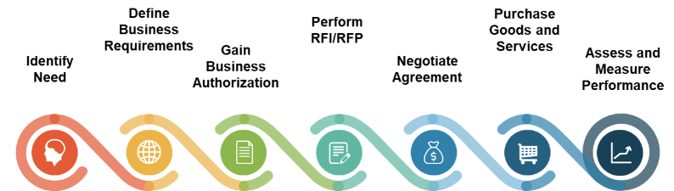
Accommodate Gen AI in your vendor procurement practices
Key questions to ask:
Does the Gen AI tool fulfill the use cases you need addressed?
Does it meet, or can it be configured to meet, your key non-functional requirements, ethics, policies, and regulations?
Are there resources available to implement and support Gen AI in the business and IT?
Is the Gen AI tool an open-source project that is actively used, developed, and supported?
Does Gen AI tool and vendor have a future?
What is the quality of the user and developer training and documentation and the state of its roadmap?
What is the right version to use?
How is training and operational data accessed, stored, prepared, and used?
Apply the same disciplined approach to Gen AI vendor selection as you would to other technology adoption.
See Info-Tech’s Rapid Application Selection Framework for more information

Slide 33





Be prepared to take the next steps
Deliver Gen AI to your solution delivery teams
You are here
Modernize Your SDLC
Adopt Generative AI in Solution Delivery
Select Your AI Vendor
Drive Business Value With Off-the-Shelf AI
Build Your Enterprise Application Implementation Playbook
Efficient and effective SDLC practices are vital, as products need to readily adjust to evolving and changing business needs and technologies.
Generative AI can drive productivity and solution quality gains to your solution delivery teams. Level set expectations with the right use case to demonstrate its value potential.
The right vendor and partner are critical for success. Build the selection criteria to shortlist the products and services that best meets the current and future needs of your teams.
Build a framework that will guide your teams through the selection of an off-the-shelf AI tool with a clear definition of the business case and preparations for successful adoption.
Your Gen AI implementation doesn’t start with technology, but with an effective plan that your team supports and is aligned to broader stakeholder and sponsor priorities and goals.
Build your Gen AI practice
AI Strategy &
Generative AI Roadmap
AI Governance
Get Started With AI

Slide 34

Murali Vemulapalli
Chief Enterprise Architect & Head of Enterprise Architecture
Arkansas Blue Cross and Blue Shield
Murali brings over 25 years of transformative experience in Information Technology and data-driven solutions across the Healthcare and Financial sectors. Presently serving as the Chief Enterprise Architect at Arkansas Blue Cross and Blue Shield, he oversees Enterprise Architecture, Business Relationship Management, Technology Innovation with special focus on Enterprise Automation. Murali's unyielding dedication to unleashing the potential of data and cutting-edge technologies has consistently fueled operational excellence, and strategic expansion.
Among his notable achievements are crafting a data collaborative platform for personalized care for millions of members, and designing an industry-leading mail order pharmacy fulfillment platform with data-driven automation capabilities, propelling it to dominate the market and generate billions in revenue. Additionally, Murali successfully delivered an enrollment hub servicing diverse healthcare business lines, benefiting tens of millions of members.
A staunch advocate of technology's potential to address business challenges and uplift society, he is actively engaged in AI-driven initiatives aimed at enhancing operational efficiencies and health outcomes for valued members. Murali's strategic insight and forward-looking approach continue to shape the landscape of healthcare technology adoption in the enterprises he serves.

Slide 35
Bibliography
“2018 AI Predictions.” PwC, 18 Feb. 2018.
“2022 AI Business Survey.” PwC, 2022.
“6 Applications of Generative AI in Industrials.” CB Insights Research, 22 Mar. 2023.
“Artificial Intelligence.” Tracxn, 3 July 2023.
“Artificial Intelligence and AI at Scale.” Boston Consulting Group, 2023.
“Artificial Intelligence Market to Hit $1,811.75 Billion by 2030: Grand View Research, Inc.” Bloomberg.com, 3 July 2023.
Chui, Michael, et al. “AI Adoption Advances, but Foundational Barriers Remain.” McKinsey & Company, 2018.
Chui, Michael, et al. “Economic Potential of Generative AI | McKinsey.” McKinsey & Company, 14 June 2023.
Chui, Michael, et al. “The State of AI in 2022--and a Half Decade in Review | McKinsey.” McKinsey & Company, 6 Dec. 2022.
Chui, Michael, et al. “What Every CEO Should Know about Generative AI | McKinsey.” McKinsey & Company, 12 May 2023.
Chukka, Padma. “Generative AI: The Missing Piece in Financial Services Industry?” Finextra Research, 21 Apr. 2023.
Close, Jim. “Is AI Still Too Expensive for Most Firms?” CPA Practice Advisor, 10 Feb. 2022.
Dhinakaran, Aparna. “Overcoming AI’s Transparency Paradox.” Forbes, 10 Sept. 2021.
Dilmegani, Cem. “4 Reasons for Artificial Intelligence (AI) Project Failure in 2022.” AIMultiple, 10 July 2023.
Dooley, Jacqueline. “8 Questions to Choose the Best Generative AI Solution.” Coveo, 13 June 2023.
Gooding, Matthew. “Three Ways Organisations Fail at Artificial Intelligence.” Tech Monitor, 27 Aug. 2020.
Haan, Kathy. “24 Top AI Statistics & Trends in 2023.” Forbes, 25 Apr. 2023.
Hughes, Owen. “Generative AI Defined: How It Works, Benefits and Dangers.” TechRepublic, 4 May 2023.
“How to Choose an AI Vendor.” DataRobot, 2018.
Lawrence, Addie. “How to Choose a Generative AI Model.” KMS Technology, 24 May 2023.

Slide 36
Bibliography
Marr, Bernard. “How to Make AI Work in Your Organization.” Forbes, 13 Apr. 2023.
Masci, Jonathan. “AI Has a Poor Track Record, Unless You Clearly Understand What You’re Going For.” IndustryWeek, 19 Jan. 2022.
Muspratt, Adam. “4 Reasons Companies Are NOT Adopting AI (and How to Resolve Them).” Process Excellence Network, 28 June 2018.
Nunez, Steve. “Why AI Investments Fail to Deliver.” InfoWorld, 15 Nov. 2021.
Peregud, Irina. “A Gentle Guide for Artificial Intelligence Vendor Selection.” InData Labs, 31 Aug. 2021.
Ransbotham, Sam, et al. “Reshaping Business with Artificial Intelligence.” MIT Sloan Management Review, 6 Sept. 2017.
Reilly, Athena, et al. “AI: Built to Scale – From Experimental to Exponential.” Accenture, 14 Nov. 2019.
Saif, Irfan, and Beena Ammanath. ““Trustworthy AI” Is a Framework to Help Manage Unique Risk.” MIT Technology Review, 25 Mar. 2020.
Spataro, Jared. “Introducing Microsoft 365 Copilot – Your Copilot for Work.” The Official Microsoft Blog, 16 Mar. 2023.
“Top Reasons Why AI Projects Fail.” Cognilytica, 7 Sept. 2022.
Van Buren, Edward, et al. “AI Readiness for Government.” Deloitte Insights, 24 Jan. 2020.
Yabsley, Peter. “Key Considerations When Choosing Generative AI for Code Tools.” Diffblue, 6 June 2023.
Zao-Sanders, Marc, and Marc Ramos. “A Framework for Picking the Right Generative AI Project.” Harvard Business Review, 29 Mar. 2023.

